Slide 1

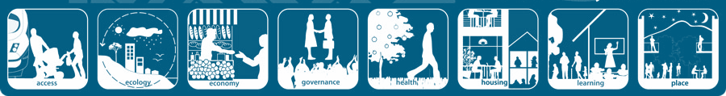
Factors Affecting the Liveability of Suburbs

Slide 2

To understand the factors that affect the liveability of suburbs

Slide 3


Slide 4

'Liveability' - the qualities of a place (city, town, suburb, neighbourhood) that contribute to the quality of life experienced by residents and others.

Slide 5
‘Liveability’ –
suburbs/neighbourhoods
The liveability of suburbs and neighbourhoods depends on the quality of a place as perceived by residents, workers, customers and visitors to the area.
These factors include:

Slide 6
Factors affecting the liveability of a suburb.
Environmental
Cleanliness, dust, pollution, noise, air and water quality, aesthetics, climate, landscape
personal security, traffic safety, community identity and pride, neighbourliness, connectedness
Social
historic structures, mature trees, traditional architectural styles, streetscapes, belief, traditions, backgrounds
Cultural
Economic
Value of property, employment opportunities, affluence, investment
streets, public transport, health, shopping centres, schools, religious institutions, parks and sporting facilities, other public facilities, communications.
Infrastructure

Slide 7



Small cows eat every icecream

Slide 8

Dalkeith, WA
Dalkeith, UK

Slide 9
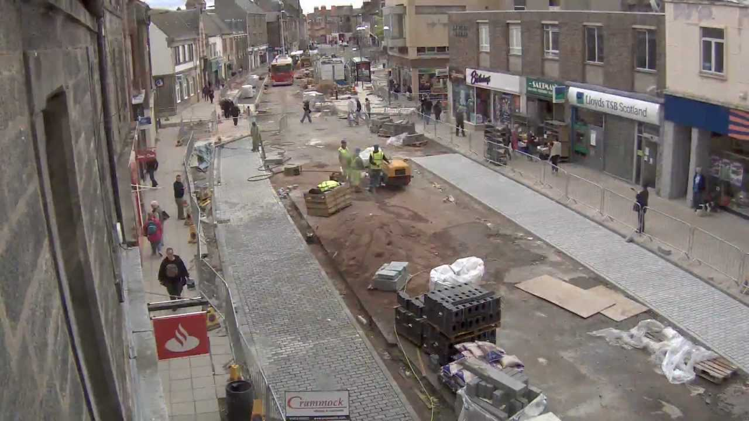
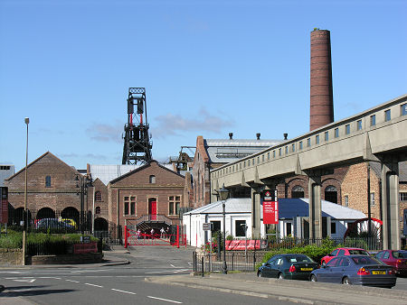
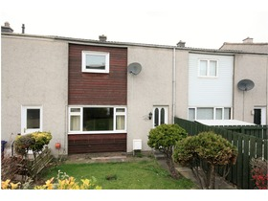

Slide 10
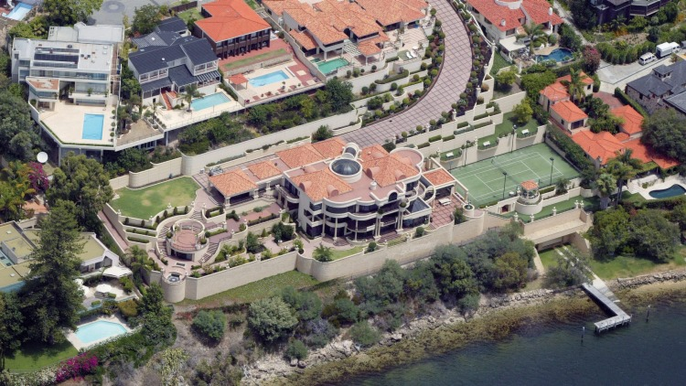
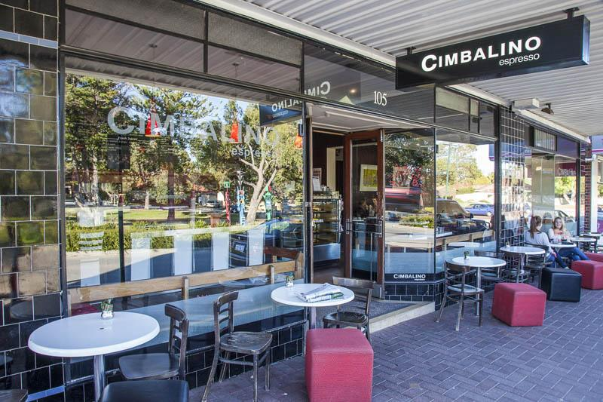
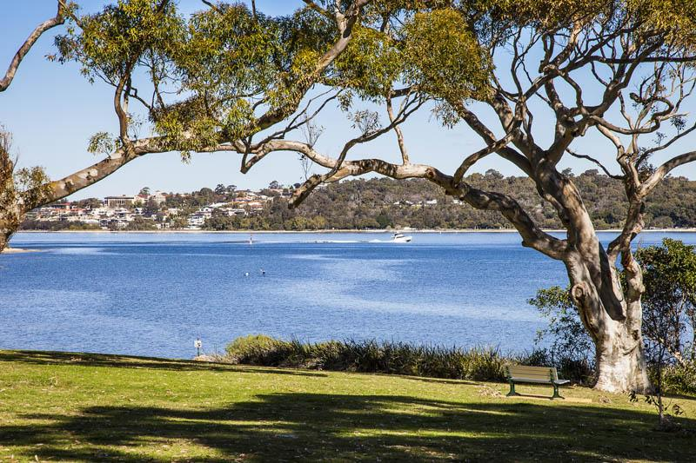
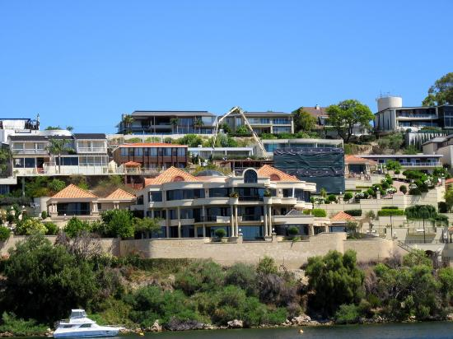

Slide 11


So which Dalkeith is more ‘liveable’?
Give reasons.

Slide 12



Slide 13
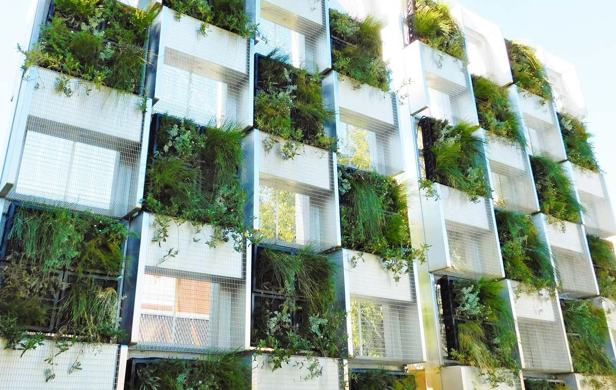
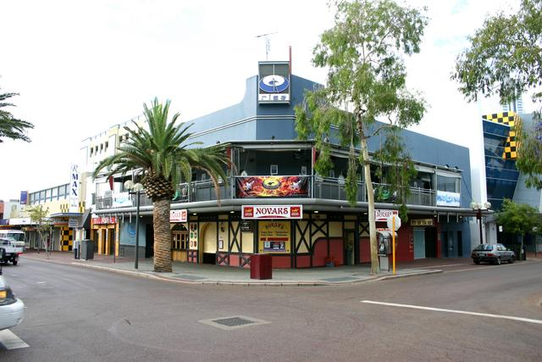
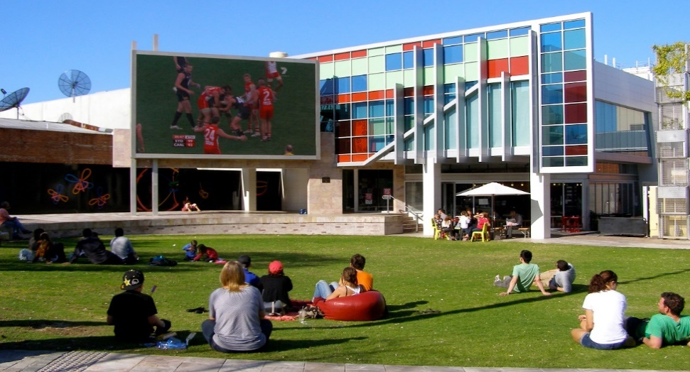
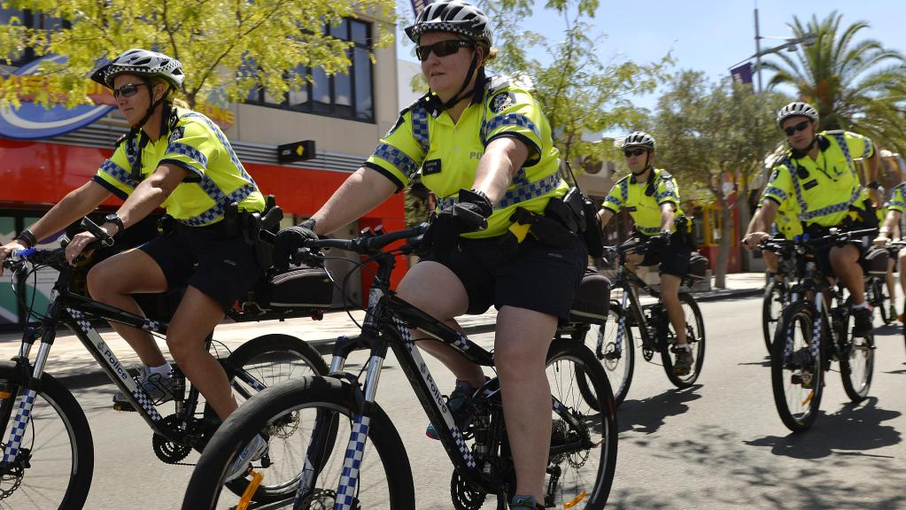
How ‘liveable’ is Northbridge’? Give reasons.
Is Northbridge more ‘liveable’ to a family with young children or an 19yo student? Give reasons.
Use the map and the photos below as well as your schema

Slide 15


So now we need to assess the liveability of your suburb
Write a TEEL paragraph (10 sentences) evaluating your home suburb's liveability - consider the factors taught in class - 15 mins max
Evaluate

Slide 16
In my opinion, Mindarie is a very liveable suburb especially for families and older couples (above 30). Socially, Mindarie is a very safe area with low crime rates and a high police presence. People feel safe walking the streets and there is a great sense of community. Many people from the UK live in this suburb creating a strong sense of togetherness with shared customs and traditions. Environmentally, Mindarie is very clean in all areas; with low air and noise pollution and good water quality. Aesthetically, Mindarie is very beautiful with many houses within walking distance from the beautiful Indian Ocean and not too far from the tranquil Swan Valley. The streetscapes of Mindarie are well laid out and well maintained as well as being very pleasing to look at. The streets are wide and clean with a mixture of housing styles, both modern and traditional. Economically, this is an affluent area with a high average yearly income, high house prices and low unemployment. Council and business investment is high in the area and people spend a large amount on the upkeep and development of their properties. Employment opportunities are limited in the area with most jobs being in the retail and service sector as there is no industry or agriculture. The infrastructure of Mindarie is rapidly improving with the development of more schools, shops and the extension of the Mitchell Freeway. School in the area have good WACE results and have a good reputation. Overall, Mindarie is a very liveable area for many people but especially families.

